Slide 1
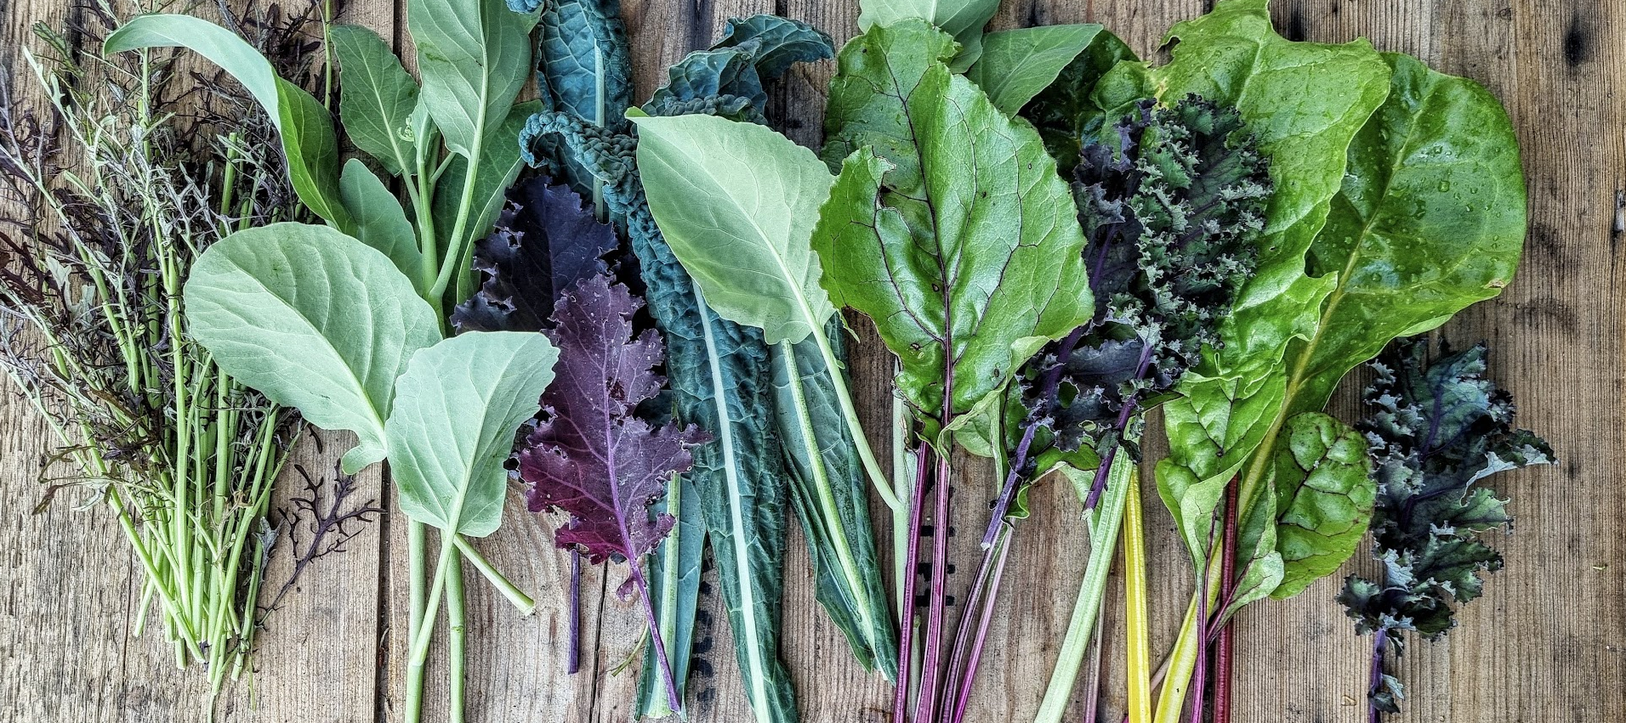


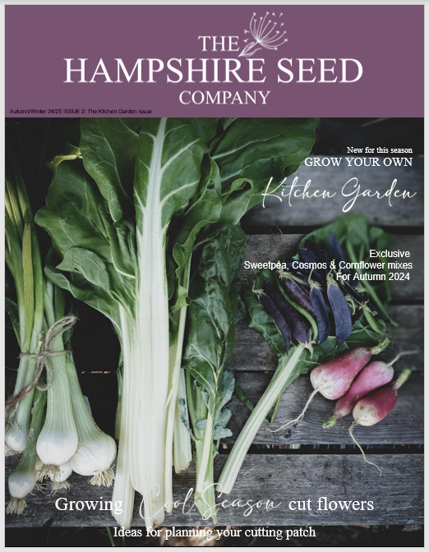
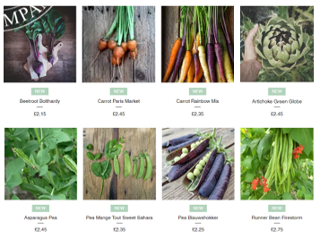
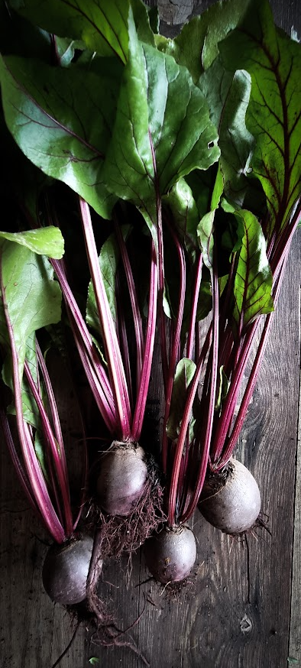
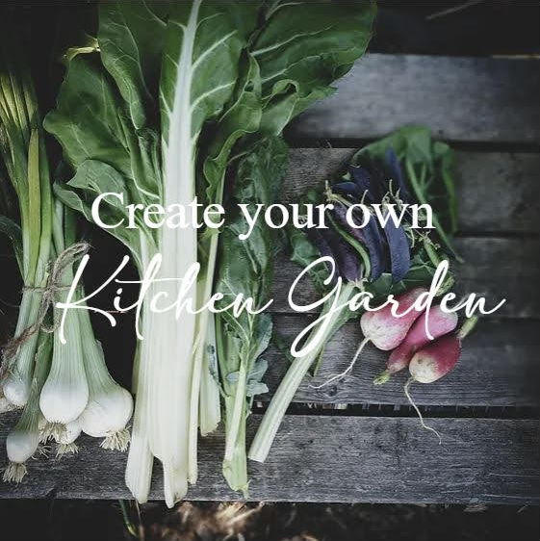
Launching Vegetable Seeds for the 2025 Season
Kitchen Garden
"Our initial launch focused primarily on flower seeds, with a particular emphasis on a wide selection of varieties perfect for cutting, including some exclusive seed mixes which are unique to our brand.
The original plan was to eventually branch out and offer vegetable seeds as well, catering to a broader gardening audience. However, there's nothing like bringing forward a great idea!
As a small, independent business, we have the flexibility and agility to respond quickly to both market demand and customer feedback. We don’t have to navigate through layers of bureaucracy or jump through hoops – we can simply make it happen when the time is right. This has allowed us to expedite our plans, and we are excited to announce that we will be offering a specially curated range of vegetable seeds for the upcoming growing season.
Our new vegetable seed collection has been thoughtfully selected to inspire both novice and seasoned gardeners alike, ensuring that all the essentials are covered—from the most popular staples to some exciting, heritage varieties which will appeal to those looking to try something new on their beg patch.
GROW YOUR OWN
Release - September 2024
Website: www.thehampshireseedco.com
Contact: Jane Westoby - Founder & Creative Director
hello@thehampshireseedco.com | 07740457730

